Slide 1


Infection Prevention & Control
San Joaquin General Hospital
Steven Sloneski, ASN, MHFA-C, RN
Infection Control Coordinator
Adriana Mejia, BSN, RN, PHN

Slide 2
Objectives
Communicate SJGH Infection Prevention Plan
Understand commonly transmitted infections within health care setting
Understand your roles in preventing infections
Describe strategies to prevent healthcare associated infections (HAI’s)
Understand transmission-based precautions (isolation)
Review safe injection practices and practices to prevent blood-borne pathogen
Understand requirements for waste management

Slide 3
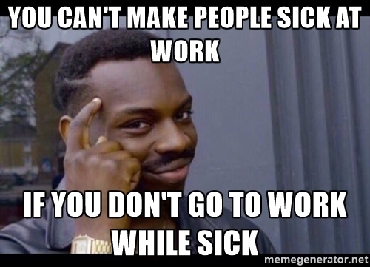
Another Risk often overlooked…
  NEVER come to work sick – ever.
  If you feel unwell or exhibit any symptoms of COVID-19, please stay home. If you have COVID-19 symptoms, contact our Respiratory line immediately at 209-468-6514.

Slide 4
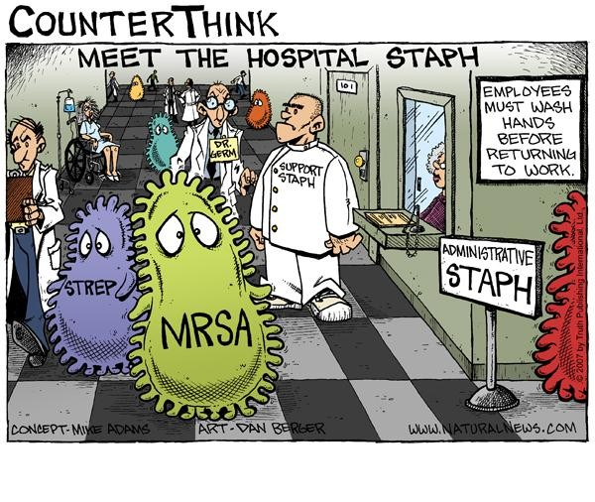
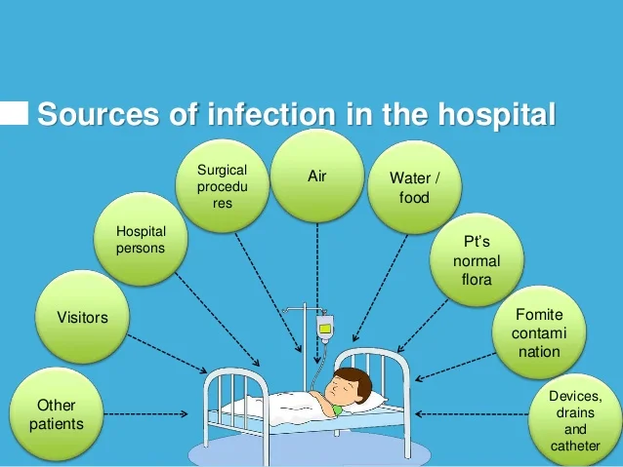
Strategies for Infection Prevention
Use Standard Precautions including hand hygiene
Surveillance for infectious diseases-what we look at every day (All positive labs and radiology)
Isolation (Transmission-Based Precautions)
Environmental Cleaning
Prevention Multi-Drug Resistance Antimicrobial Stewardship

Slide 5
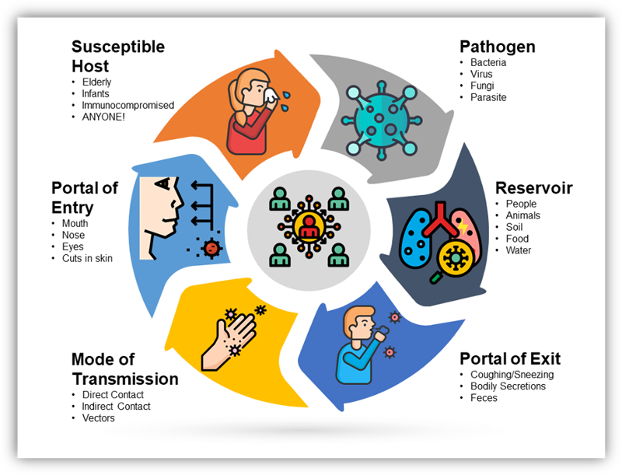
Chain of Infection

Slide 6
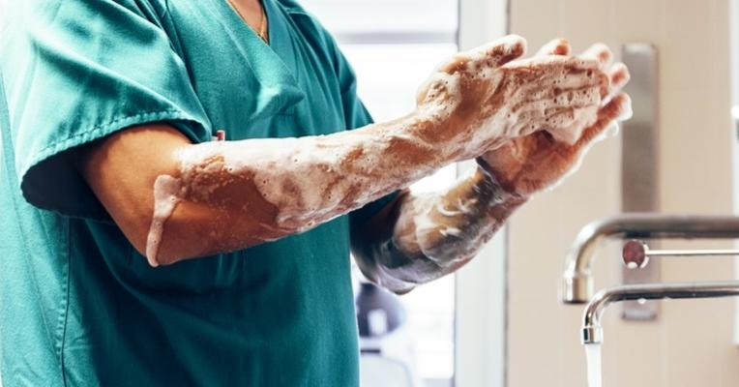
What are HAI’s?
Healthcare Associated Infections
On any given day, 3-4% (or 1 in 30) hospital patients get an HAI
Approximately 2 million patients per year
Lathrop, Manteca, and Ripon (their combine population die from HAI each year)

Slide 7
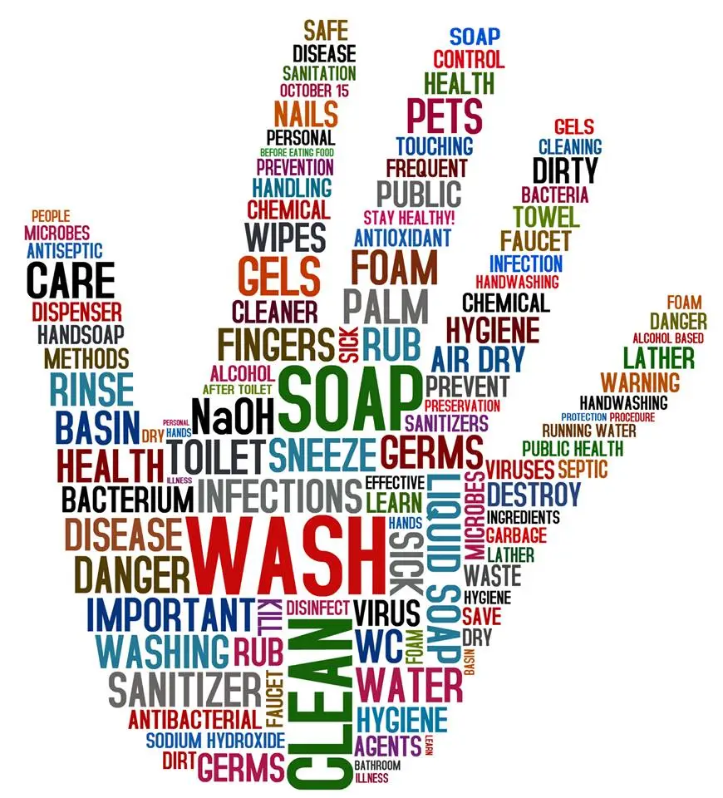
NATIONAL PATIENT SAFETY GOAL #07:
REDUCE RISK OF HEALTH CARE ASSOCIATED INFECTIONS (HAI’S) USING EVIDENCE-BASED PRACTICES
HAND HYGIENE
Use Hand Cleaning Guidelines from the CDC (Centers for Disease Control).
Set goals and use them to improve hand hygiene
Our goal is 95% (we range between 89-95%)
Hand Hygiene observations occur house-wide to include staff, volunteers, students, and visitors entering and exiting patient care areas.

Slide 8
Why is Hand Hygiene Important?
Infections are a serious problem in healthcare facilities.
Every year, an estimated 2-3 million patients get a hospital-related infection.
Many infections are transmitted on the hands of healthcare personnel.
Hand hygiene is part of Standard Precautions. It can reduce the transmission of healthcare-associated infections – to your patients and to you.
https://www.youtube.com/watch?v=LvRP3c5n3P8
Video

Slide 9
When should healthcare workers practice hand hygiene?
5 Moments for Hand Hygiene
Before entering room and touching a patient – Each encounter
Before clean or aseptic procedure or handling invasive medical devices
After blood, body fluids, or contaminated surfaces
After touching a patient or their surroundings
When leaving room
(WHO, 2006)

Slide 10
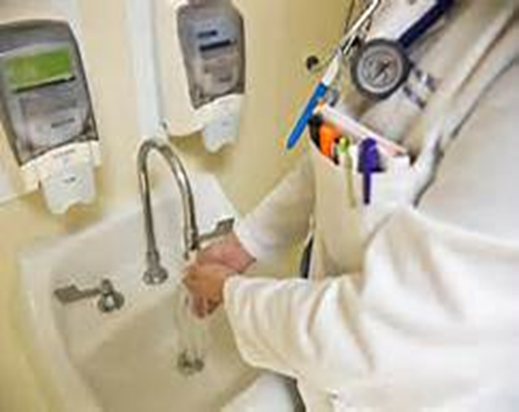

Additional moments for health care workers to practice hand hygiene… just a reminder!
Before moving from work on a soiled body site to a clean body site on the same patient
Immediately after glove removal
After using the restroom/ and before eating or handling foods
Before/After medication administration
(CDC, 2021)

Slide 11
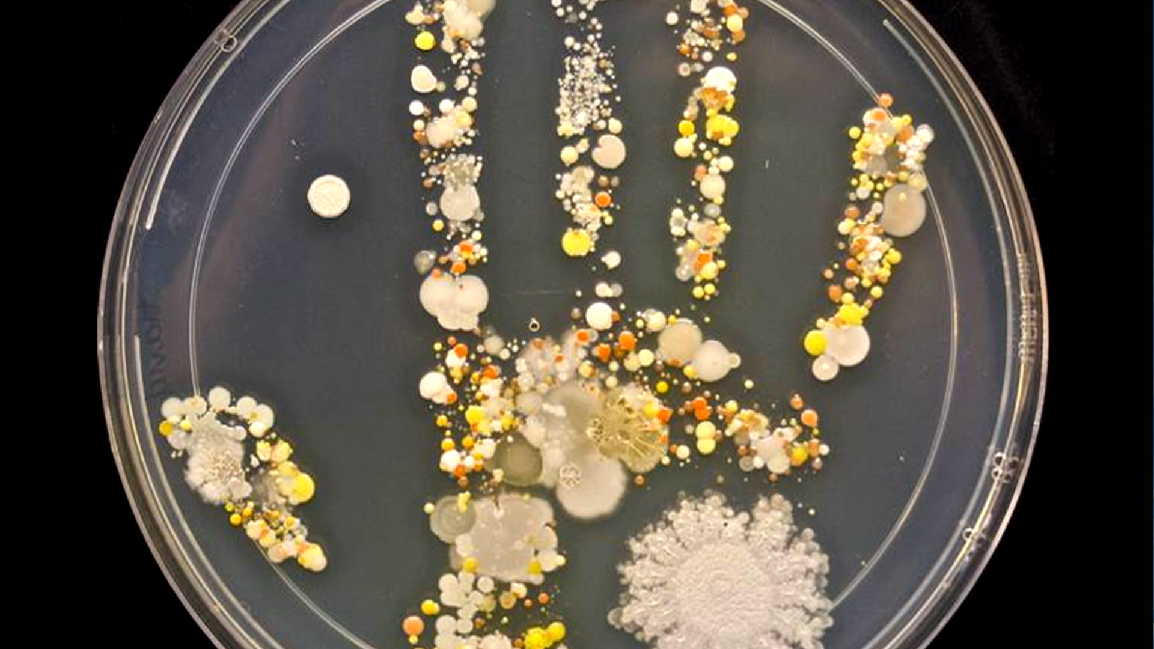
Which product should I use?
Alcohol-based hand sanitizer is preferred
For non-visibly-soiled hands
Use after removing gloves
Use after dry skin contact
Quick, effective, kind to skin
More effective than soap and water for killing bacteria
NEVER use for C-diff rooms (not effective sporicidal)

Slide 12
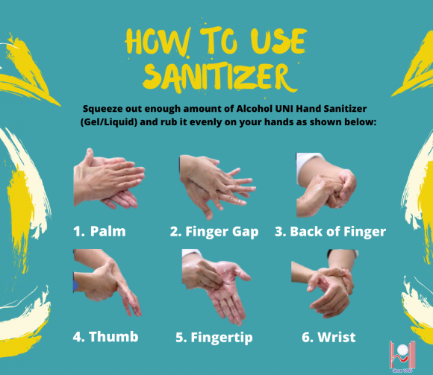
Hand Hygiene 101
Sanitizers
WHO: How to handrub? With alcohol-based formulation (youtube.com) Video

Slide 13

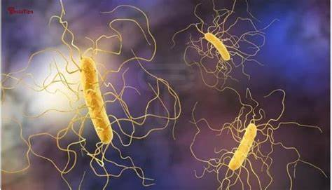
When do I use Soap & Water?
When your hands are visibly soiled
After going to the restroom
Before and after you eat OR drink anything
After known or suspected exposure to Clostridium difficile (C. diff) 29,000
After known or suspected exposure to patients with infectious diarrhea from Norovirus
Known exposure to Bacillus anthracis (anthrax)

Slide 14
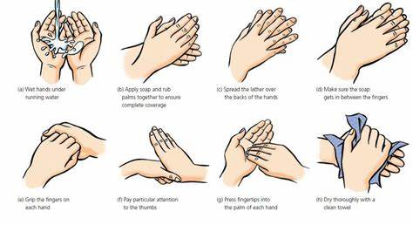
Hand Hygiene 101
Soap and Water
Hand-washing Steps Using the WHO Technique – YouTube Video

Slide 15

ANTIMICROBIAL STEWARDSHIP
The key elements of antimicrobial stewardship are:
To ensure we prescribe the right antibiotic, antiviral, antifungal for the patient
Consider age, medical conditions, pregnancy, or long-term care resident choose the right dose, duration, and route for the condition you are treating
Mandated by CDC as of 2024 and we report our use of Antibiotics and the organisms that the patient was being treated for
Why is Antimicrobial Stewardship Important? (youtube.com) Video
Reference: David Boan, PdD; Paul Cook MD; Christopher Crnich MD; et al. “What Every Health Care Executive Should Know: The Cost of Antibiotic Resistance” Joint Commission Resources , June 2009.

Slide 16
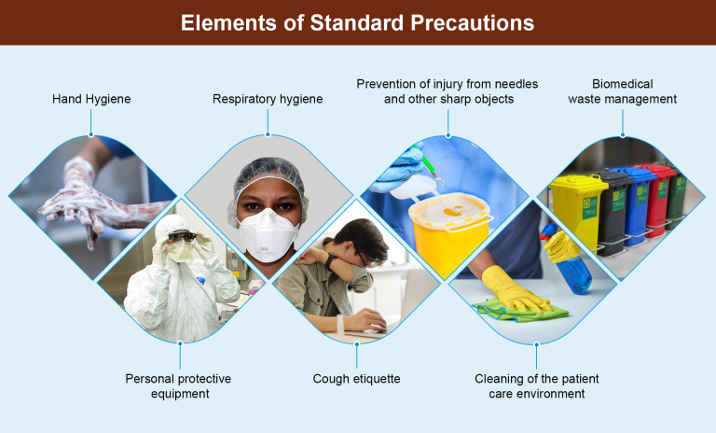
Standard Precautions
TREAT ALL BLOOD AND BODY FLUID AS POTENTIALLY INFECTIOUS
Applies to ALL patients regardless of diagnosis or ID status
Key elements of Standard Precautions include:
Risk assessment
Hand hygiene
Respiratory hygiene and cough etiquette
Patient placement (isolating those appropriate)
Personal protective equipment
Aseptic technique
Safe injections and sharps injury prevention
Environmental cleaning
Handling of laundry and linen
Waste management
Decontamination and reprocessing of reusable patient care items and equipment (SPD)

Slide 17
  Fingernails (Direct clinical staff, support staff and dietary)
  No artificial nails, extenders, tips, or gels.
  Natural nails no longer than ¼ inch beyond nailbed.
  Nail polish not be chipped.
  Nails clean and trimmed.
  Hand Health
  Hand hygiene: Wet hands before applying product.
  Cuticles, hands and forearms w/o oozing areas. Breaks in skin integrity clean and covered with waterproof dressing.
  Limit jewelry on hands and wrists. If worn, plain wedding band preferred.
  Lotion
  Recommended: Before Starting Work; After Hand Hygiene; Before Breaks, Before Leaving Work.
  Hospital-approved product.

Slide 18

C. diff PREVENTION (Clostridium difficile)
C. diff can live on people's skin. People who touch an infected person's skin can pick up the germs on their hands.
Make sure all healthcare providers clean their hands before and after caring for you. Ask them to clean their hands if you don't see them do so. Must use soap and water
While caring for you and other patients with C. diff, healthcare providers will use certain precautions like wearing a gown and gloves. This will prevent the spread of C. diff to themselves and other patients.
Assure proper Daily and Terminal Cleaning is performed

Slide 19
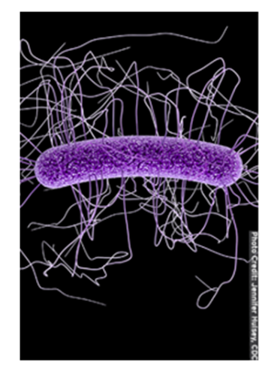
Pathogens survive on surfaces
Pathogen | Length of survival
Acinetobacter sp. | 3 days to 5 months
Adenovirus | 7 days-3 months on inanimate surface
Influenza | 24-48 hrs on nonporous surfaces
Coronavirus | 72 hrs on non-porous surfaces
RSV | 6 hrs
Norovirus | 8 hr-7 days on inanimate surface, <14 days stool
Rotavirus | 6-60 days
C-difficile | 5 months on hospital floors
MRSA | 7 days to 7 months
Pseudomonas | 6 hours-16 months; on dry floor: 5 weeks
VRE | 5 days to 4 months
CDC Science Brief: SARS-CoV-2 and Surface (Fomite) Transmission for Indoor Community Environments. 2021
Kramer et al. BMC Infect Dis 6, 130 (2006). https://doi.org/10.1186/1471-2334-6-130

Slide 20
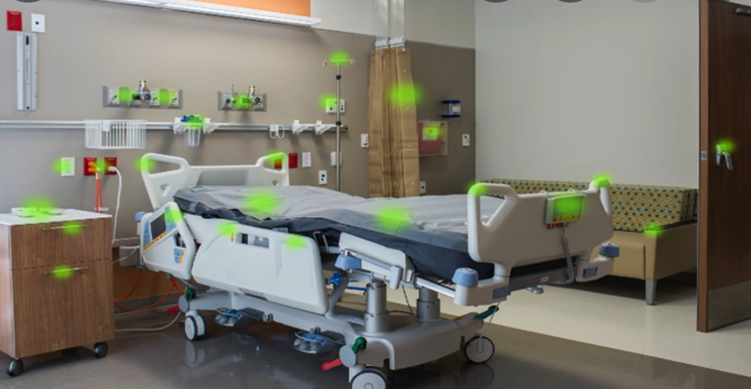
High Touch Surfaces – “Patients Surroundings”

Slide 21
Strategies to improve Environmental Hygiene
Healthcare environmental hygiene comprises cleaning all surfaces in hospital rooms and plays a crucial role in infection prevention and control. For this practice to be effective, it relies on adequate cleaning products and supplies, best practices-based protocols, training, education and quality control, and the institutional safety climate.
Clean the general hospital environment & Clean shared equipment items
Source Control: Reduce contamination of the environment by patients.
Promptly Clean Soiled Equipment and Environmental Surfaces before drying. All surfaces/lumens- use friction.
Safe and Effective Use of Disinfectants.
Cleaning and Disinfection of High Touch Surfaces in Patient-Care Areas

Slide 22
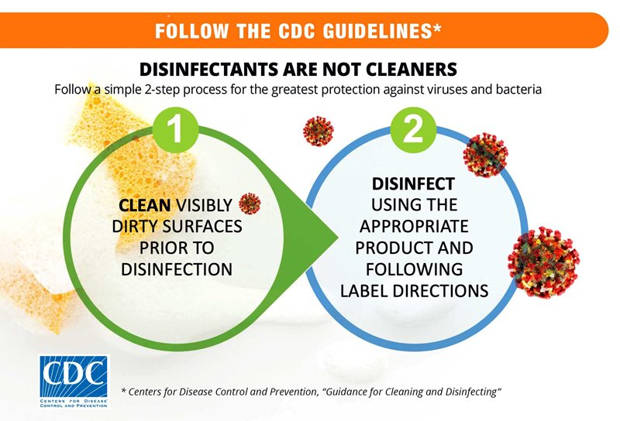
Step 1: Clean visibly soiled equipment
    may use a wipe
    remove blood and/or potentially infectious material
Step 2: Disinfection of equipment
    thoroughly wet surface with product
    allow for the appropriate wet contact/dwell time depending on product used
Two-Step Cleaning Process

Slide 23
Cleaning Before Disinfecting
Cleaning removes large numbers of microorganisms from a surface that would otherwise interfere with the disinfection process
Disinfectants are not as effective in the presence of organic material
Important: A thorough cleaning must occur before a surface can be disinfected!

Slide 24
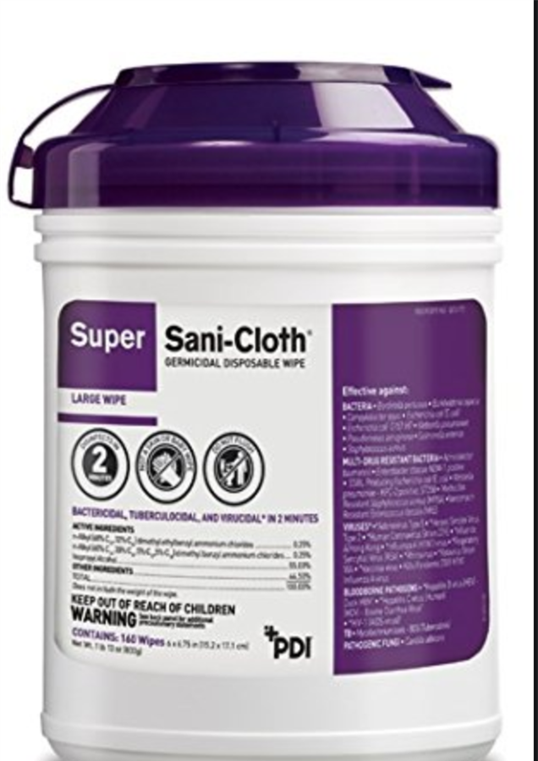
Contact Time AKA “Dwell Time”
Dwell Time: The time a disinfectant is in direct contact with a surface, and remains wet, for an item to be effectively disinfected.
The surface of the item must be wet for the duration of time specified on the canister
Start Time
Application of product
End Time
Drying has occurred
DWELL TIME 2 MINUTES

Slide 25
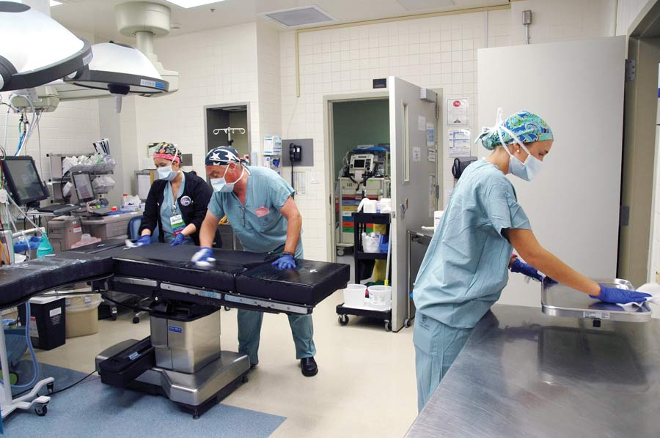
Dwell Time Scenarios
A. Wipe an entire OR table and then wait 2 minutes for anyone to use it?
B. Continuously wipe the OR table for 2 minutes then let it dry before use?
Is it A or is it B?
And the answer is………

Slide 26
Dwell Time Scenarios
B

Slide 27
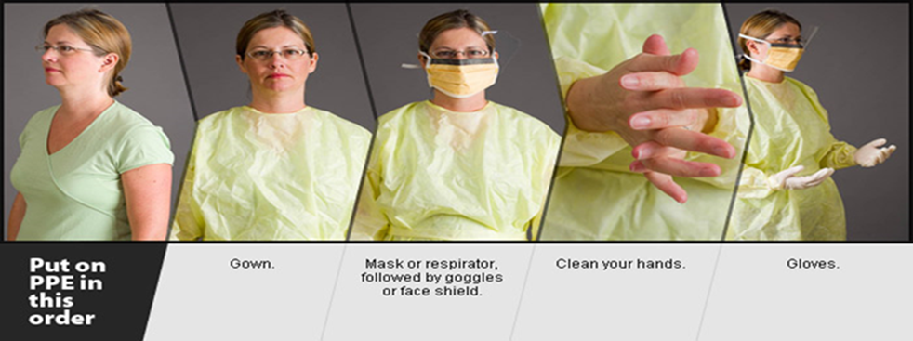
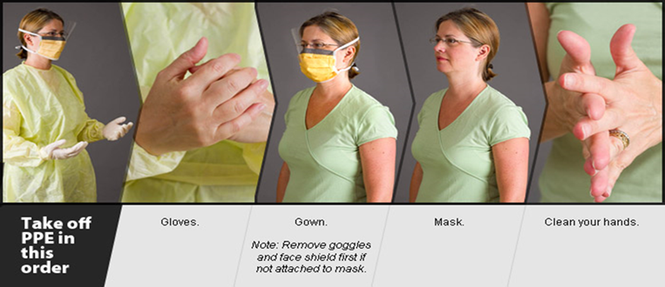
PPE Donning & Doffing
Perform hand hygiene before donning gloves
Perform hand hygiene upon completion of removal of gloves, gown, mask, and eye shield
Remember gloves do not replace hand hygiene!

Slide 28
Transmission-Based Isolation Precautions
Precautions start before you enter a patient’s room – Anticipate the supplies you will need
Leave all signage up, EVS will remove after the room has been terminally cleaned
Communicate:
Notify receiving department/hospital before transferring the patient of ALL ISOLATION required. Use required form for all transfers out of facility.
Contact Precautions
Contact Precautions w/ enteric precautions- C. diff only- alcohol gel removed from room; appropriate disinfectant and floor cleaning – Droplet Precautions
Enhanced Droplet/Contact (COVID) --- N95
Droplet surgical mask
Airborne Precautions N95

Slide 29


Enteric Contact Isolation (Special)
When entering a room with enteric contact precautions, washing with soap and water required.
Closteroides difficille (C diff)
Must only use soap and water – Hand sanitizer gels are NOT effective for HH
Room cleaned with specialized cleaner – Oxycide – NOT BLEACH
Bleach found not to be effective in most recent data and research

Slide 34

Does a COVID-19 Patient need Airborne Isolation?
No. Airborne Isolation is preferred but not mandated by CDC
COVID patients can go in single room, door shut, Contact plus Droplet isolation, MUST WEAR N95
COVID – ALWAYS AN N95

Slide 35
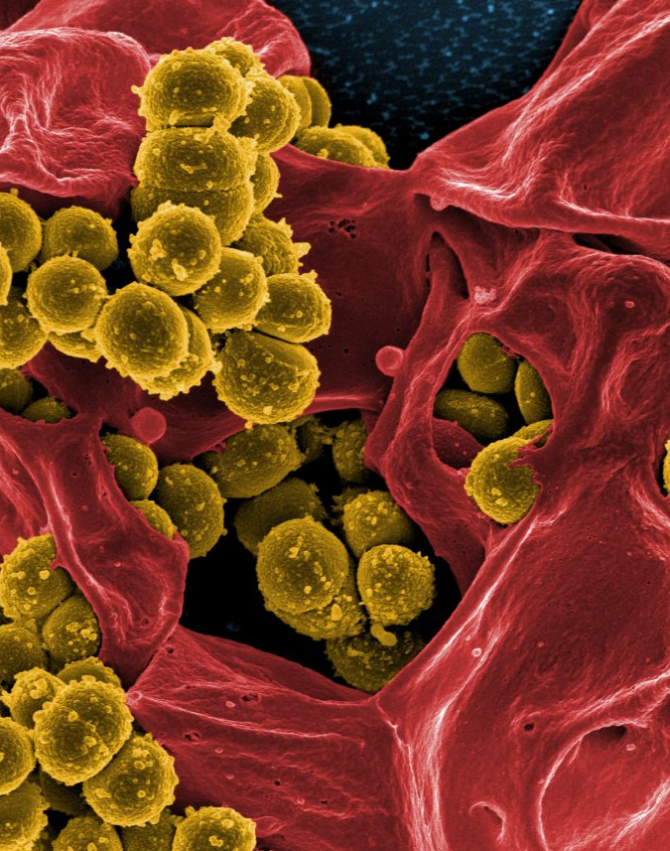
MRSA – Methicillin Resistant Staph aureus (SB 1058)
  Methicillin-resistant Staphylococcus aureus (MRSA) infection is caused by a type of staph bacteria that's become resistant to many of the antibiotics used to treat ordinary staph infections.
  MRSA infections occur in people who've been in hospitals or other health care settings, such as nursing homes and dialysis centers.
  Hospital Acquired -MRSA can spread by health care workers touching people with unclean hands or people touching unclean surfaces.
  Another type of infection has occurred in the wider community — among healthy people. This form, community-associated (Community Acquired-MRSA), often begins as a painful skin boil. It's usually spread by skin-to-skin contact.

Slide 36
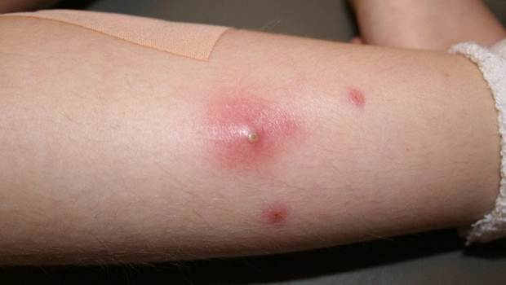
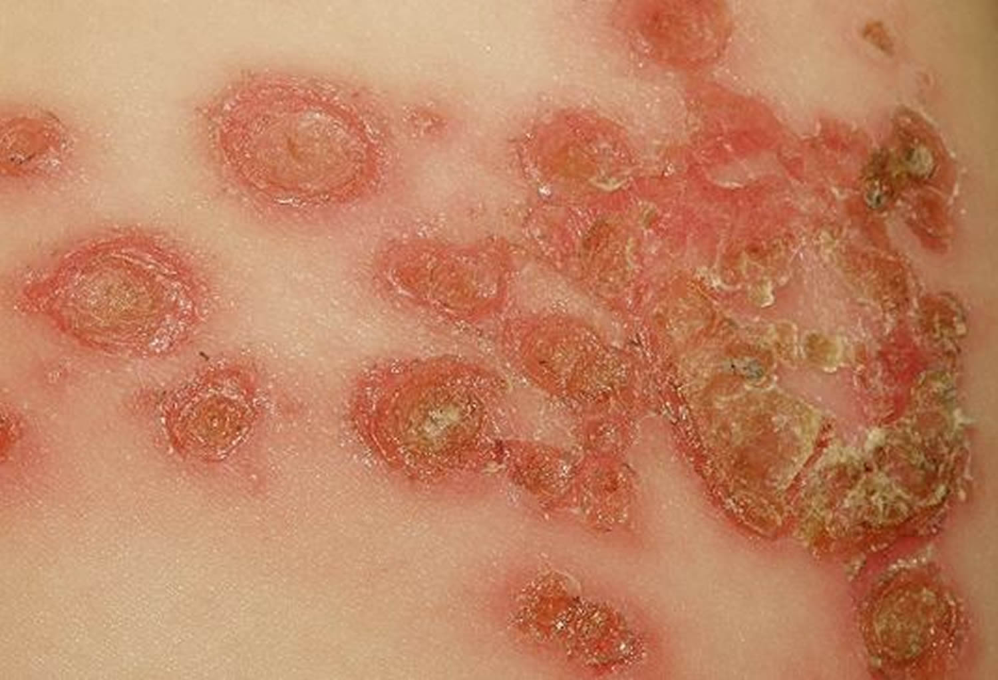
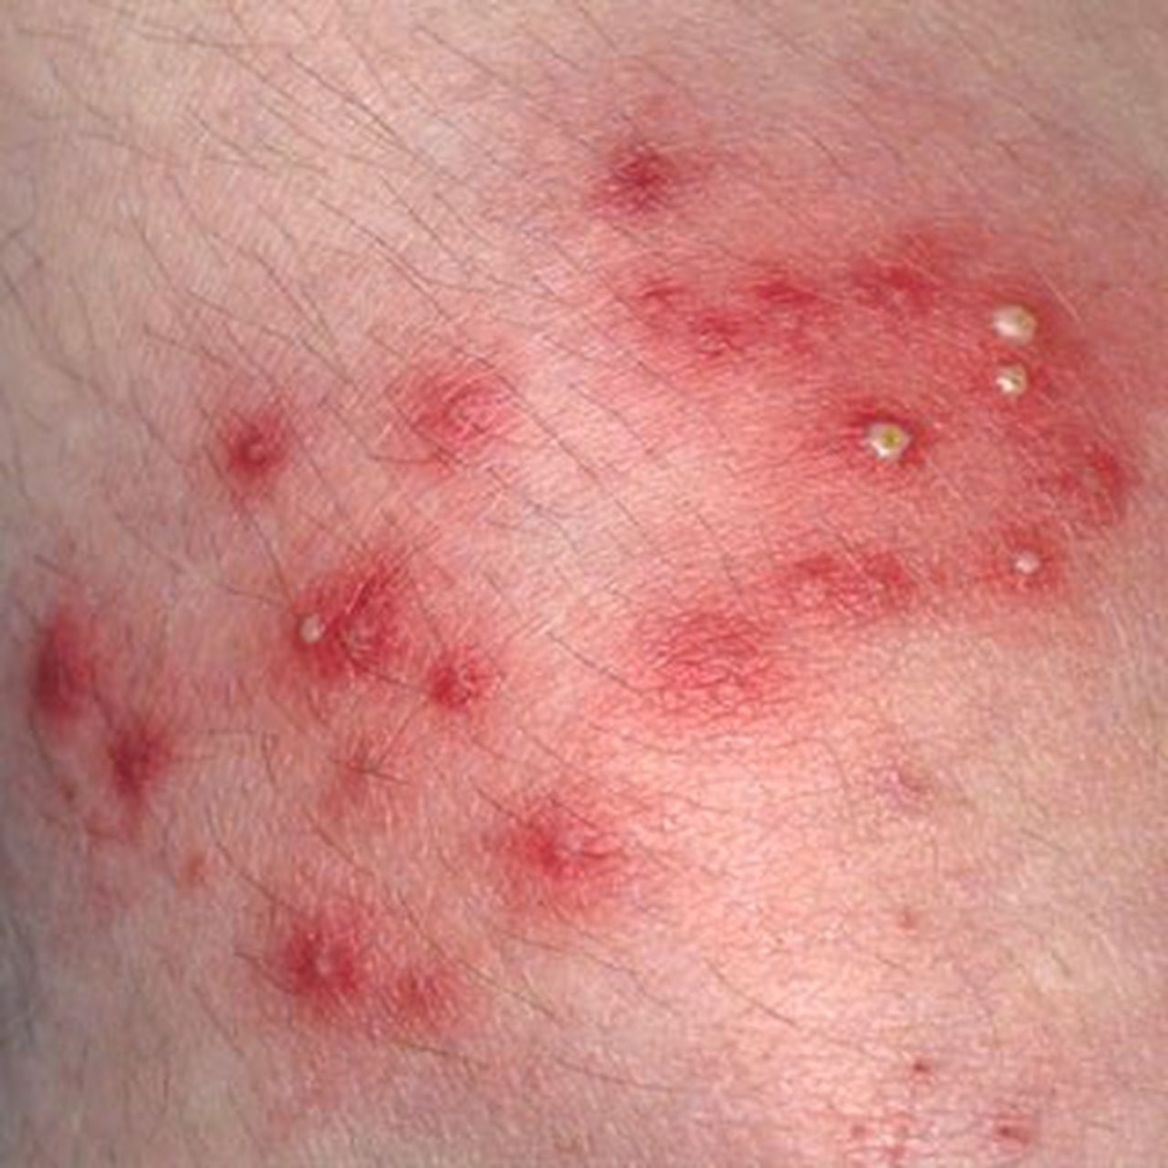
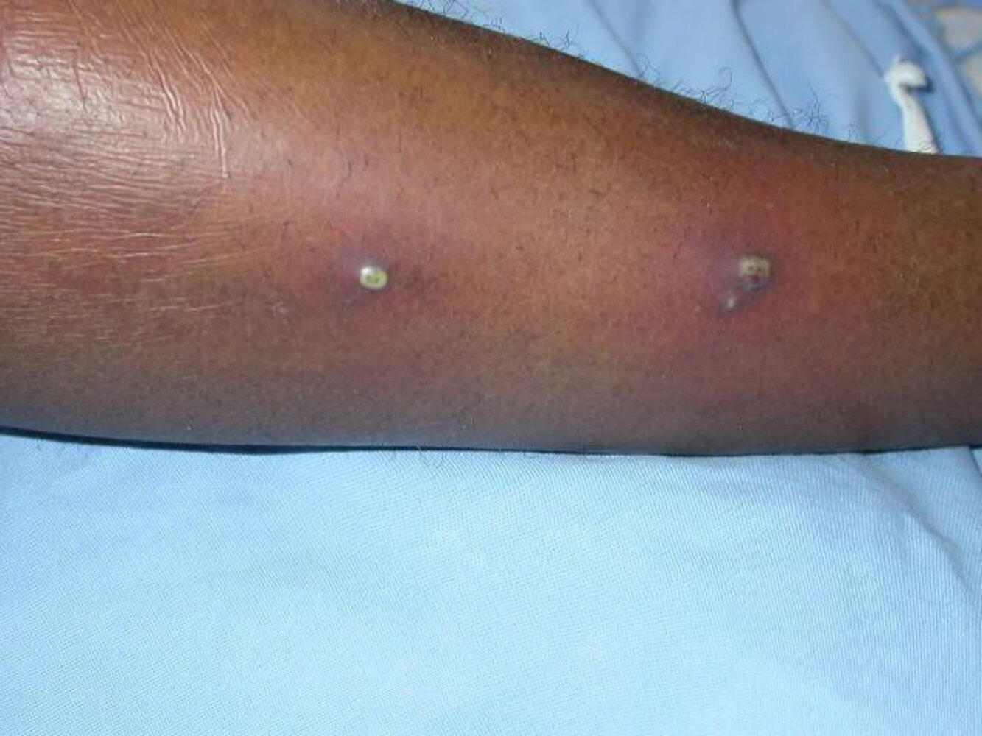
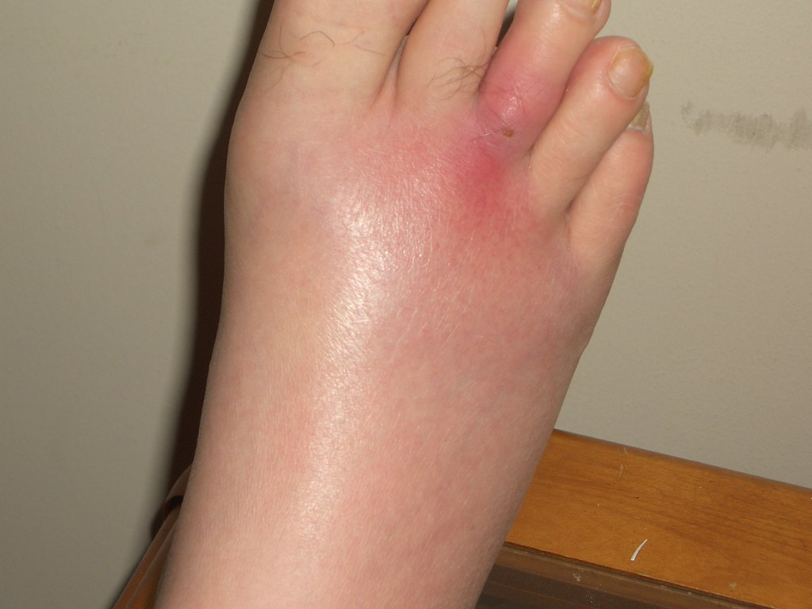
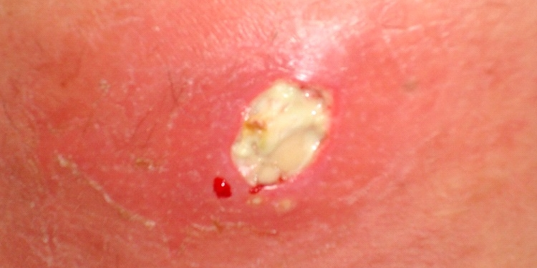

Slide 37
MRSA Isolation
Contact Precautions on admission for ACTIVE disease
Active Disease: Open and Draining wounds or current respiratory illness
Can be cohorted
Isolation for Nares/Colonization is not needed

Slide 38
Surveillance Testing for MRSA: Swab nares on admit if:
Transferred from Skilled Nursing Facility (or High-Risk Healthcare Facility determined by Physician)
Discharge from an Acute Care Hospital within 30 days of the admit
Admit to ICU within 24 hours of admission (Admit to ICN from another hospital)
ALL dialysis patients ON DISCHARGE
Susceptible immunocompromised surgery patient determined within 1st 24 hours admit, determined by Physician.
Positive for MRSA? Documented MD notification of patient or responsible party; documented teaching to prevent transmission of MRSA; documented notification of receiving hospital/SNF on discharge.
****Put Chart alert on the EMR****

Slide 39
Other Pathogens of Importance we routinely monitor
Influenza
TB- 61 Active cases in SJGH in 2025- Newly diagnosed here!
Candida auris- None in San Joaquin County, YET!
Legionella – Present in another facility in San Joaquin County
SARS-CoV-2 – Covid
Acinebacter- A. baumannii is the most concern. Specific to Hospitals and spreads like wildfire! Must practice great Hand Hygiene and Isolation precautions to prevent its spread!

Slide 40
Tuberculosis, TB
(Mycobacterium tuberculosis)
Tuberculosis (TB) is a disease caused by germs that are spread from person to person through the air.
TB usually affects the lungs, but it can also affect other parts of the body, such as the brain, the kidneys, or the spine.
A person with TB can die if they do not get treatment. It is thought that 25% of the population of the world has been infected by TB
The general symptoms of TB disease include feelings of sickness or weakness, unintended weight loss, fever, and night sweats, blood in sputum, travel and stay in a foreign country for 30 or more days. The symptoms of TB disease of the lungs also include coughing, chest pain, and the coughing up of blood.
TB gets into the air when a person with TB disease of the lungs or throat coughs, sneezes, speaks, or sings. These germs can stay in the air for several hours, depending on the environment..

Slide 41
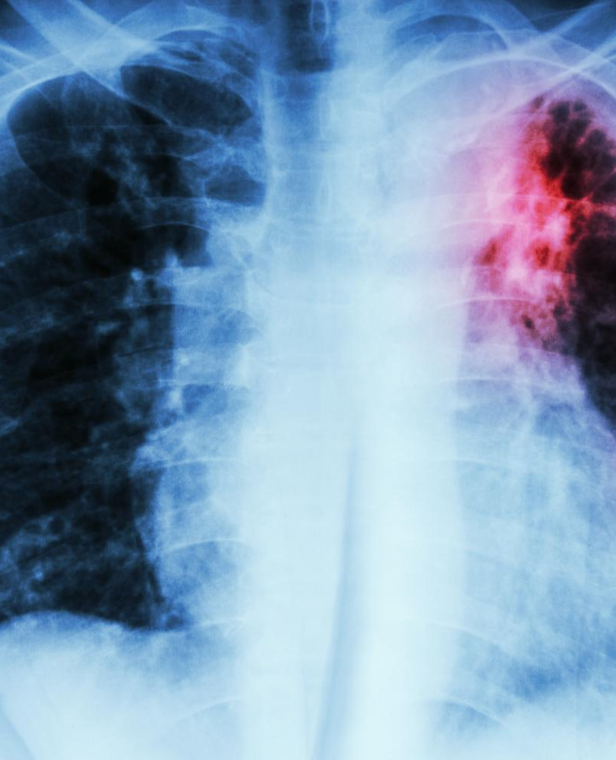
Tuberculosis, TB
(Mycobacterium tuberculosis) (cont.)
TB disease can be treated by taking several drugs for 6 to 12 months.
It is very important that people who have TB disease finish the medicine and take the drugs exactly as prescribed. If they stop taking the drugs too soon, they can become sick again; if they do not take the drugs correctly, the germs that are still alive may become resistant to those drugs.
TB that is resistant to drugs is harder and more expensive to treat.
In some situations, staff of the local health department meet regularly with patients who have TB to watch them take their medications. This is called directly observed therapy (DOT). DOT helps the patient complete treatment in the least amount of time.
HIGH background rate of TB in San Joaquin County
What You Need to Know About Tuberculosis Fact Sheet | Tuberculosis (TB) | CDC

Slide 42
Tuberculosis, TB
(Mycobacterium tuberculosis) (cont.)
Suspected Infectious TB Patient:
Unless the individual’s condition has been medically determined to result from a cause other than TB
You can place patient in isolation upon your assessment
Is a person known, or with reasonable diligence should be known, to have TB infection and has signs and symptoms of pulmonary or laryngeal TB.
Has a positive acid-fast bacilli (AFB) sputum smear, or
Has a persistent cough lasting 2 or more weeks, fever, night sweats, fatigue, unexplained/unplanned weight loss, hemoptysis, foreign travel with stay for over 30 days, known exposure to person with TB
Has been started on anti-tuberculosis medications for clinical suspicion of active pulmonary or laryngeal TB but has completed less than 2 weeks of treatment or has not demonstrated clinical response.
Additional symptoms or risk factors: HIV infection, homelessness, alcoholism or drug abuse, poor nutrition.

Slide 43
TB: Early Identification and Treatment
Prompt patient Respiratory Hygiene/Cough Etiquette
Ventilation: Airborne Infection Isolation Room (AIIR, Negative Pressure Room) with door closed.
Fast Track Placement in AIIR. Contact Nursing Supervisor if AIIR not available. Place in single patient room w/ procedure mask on patient and close door, until AIIR is available.
Tissue Test on AIIR, by assigned RN at beginning of shift.
Essential Caregivers and Visitors Only
Defer Aerosol-Generating Procedures until AIIR available when possible.
Transfer patient w/ procedure mask in place.
Discharge Plan approved by San Joaquin County Public Health Services – MANDATED PT cannot be discharged with out their approval. After Hours, weekends and holidays, contact SJGH Operator who will get you the On call SJVCPHS Rep

Slide 44
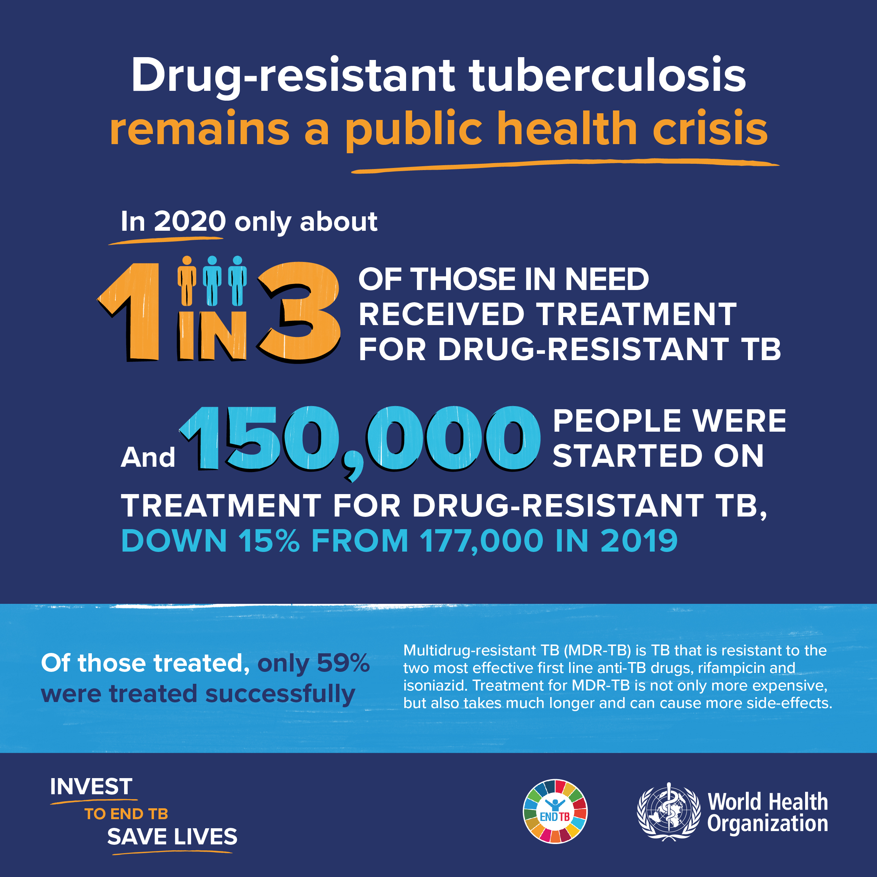
Multi Drug Resistant TB can be caused by:
Incomplete Treatment
Interrupted Treatment
Lack of adequate anti-TB Treatment
MDR-TB and XDR-TB strains resistant to conventional TB treatment
We have these strains in our community now!

Slide 45
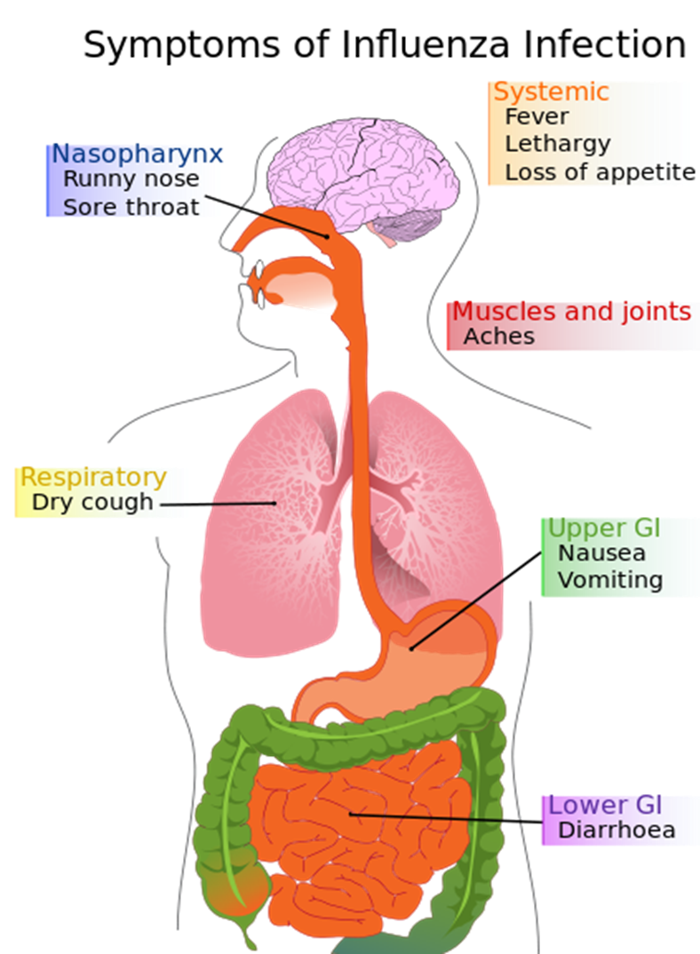
Who needs a flu vaccination?
“EVERYONE”

Slide 46

Who is at Risk for needlestick?
Healthcare personnel at risk for exposure to contaminated sharps (% exposures/job class):
RN (51%)
LVN (3%)
NA (7%) OCA (2%)
Physician/Std (24%)
Resp Therapy (1%)
OR/SPD Tech (5%)
Housekeeper (2%)
Laundry (0%)
Security (0%)

Slide 47

Who is at Risk for needlestick? (cont.)
Medical Student/Resident injuries:
Suture needles (44%)
Hypodermic needles/syringes (22%)
Scalpel (10%)
Clinicians doing an injection procedure:
Manipulating needle in patient (18%)
Recapping needle (14%)*

Slide 48

If you sustain a needlestick or sharps injury:
WASH the wound immediately with soap and water
FLUSH with water.
Notify your supervisor
Call Nursing Supervisor if your supervisor is not here
REPORT the incident IMMEDIATELY – NO EXCEPTIONS!
Fill out an Employee Accident Report & BBE form
Goal of treatment: within 2 hrs.
DISCUSS the risk of infection based on the circumstances of the injury
FOLLOW-UP as directed by Nursing Supervisor (EHS or ED)

Slide 49

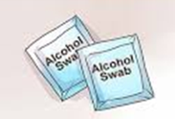
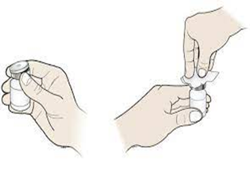
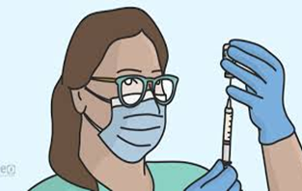
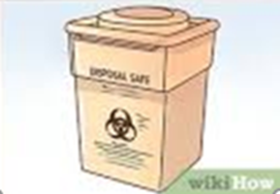
Medication Administration
USE ASEPTIC TECHNIQUE
Hand Hygiene
Use a new needle and new syringe for every injection
Disinfect the medication vial by rubbing the diaphragm (Rubber top) with alcohol for 5 seconds & allow to dry
Draw up all medications in a clean medication preparation area- area wiped with appropriate cleaning wipe
Discard all used needles and syringes and vials after the procedure is over in the sharps box.
Never, ever, ever Recap a needle – Never. (don’t even think about it)

Slide 50

Safe Injection Practice
SINGLE DOSE VIAL (SDV):
SINGLE patient, SINGLE procedure or injection
No antimicrobial preservative
Do not save left over medication
Discard after use
Rubber not sterile. Wipe with alcohol for 5 seconds and let dry before accessing vial
If it has already been accessed (e.g. needle-punctured), throw it away.

Slide 51
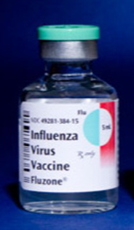
MULTIPLE DOSE VIAL
Must have original manufacturers label
Label with Month/Day/Year format (ex: 6/1/2023) when you use for the first time
May be used for more than one patient with aseptic technique *IDEALLY ONLY ONE PATIENT*
Contain antimicrobial preservative-no effect on bloodborne viruses (ie. Hepatitis B/C, HIV)
Do NOT use when:
  The beyond-use date has been reached
  Doses are drawn in a patient treatment area (must be in med room)
  Any time vial sterility is in question
WHEN IN DOUBT, THROW IT OUT

Slide 52
Protect Yourself, Co-Workers, and Your Patients
Use safer needle devices and needleless devices to decrease exposures. disposable syringes and winged steel needles (butterflies)
Avoid hurried care. - don’t rush!
Plan for safe sharps disposal.
Discard contaminated sharps immediately or when feasible in appropriate container.
Do not bend, recap, or remove contaminated needles.
Wear gloves whenever blood or body fluids are present.
Wear gowns and face/eye protection whenever blood or body fluid exposure is possible.
All healthcare workers at risk should be immunized against Hepatitis B.

Slide 53
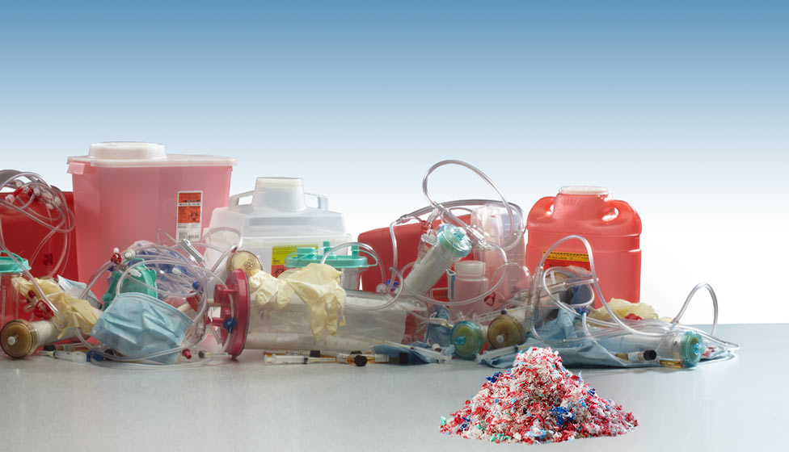
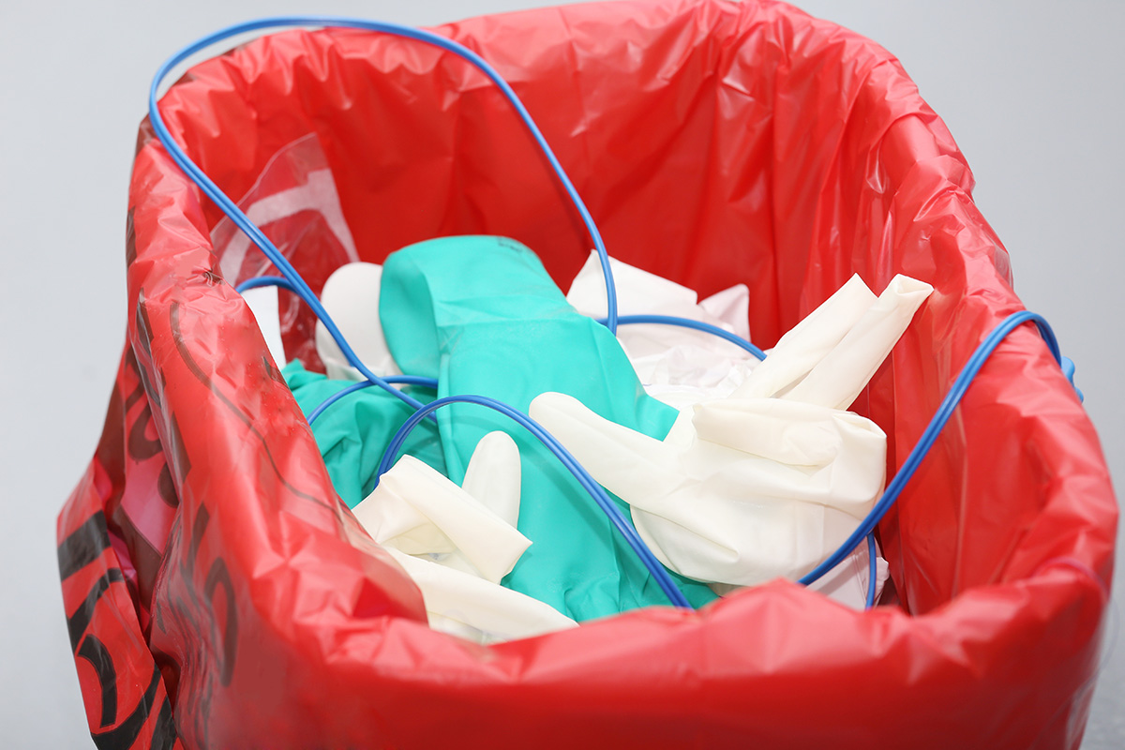
Waste Management

Slide 54
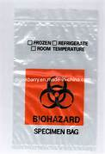
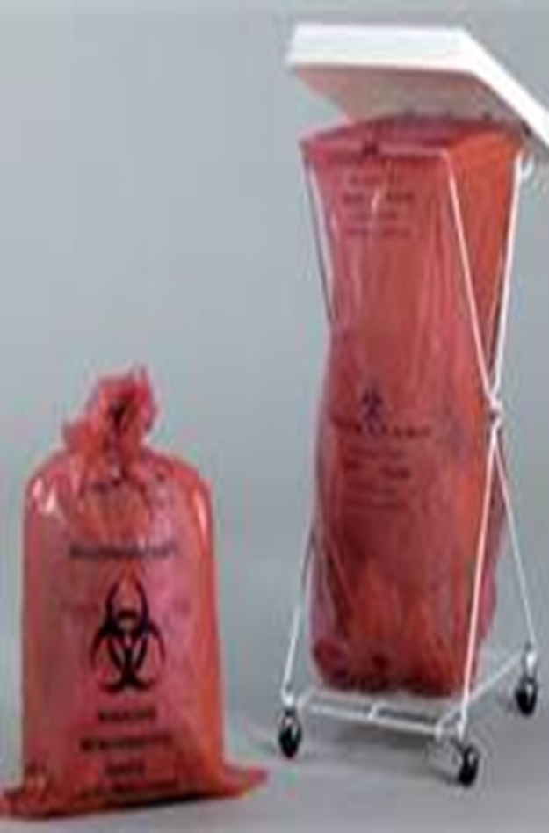
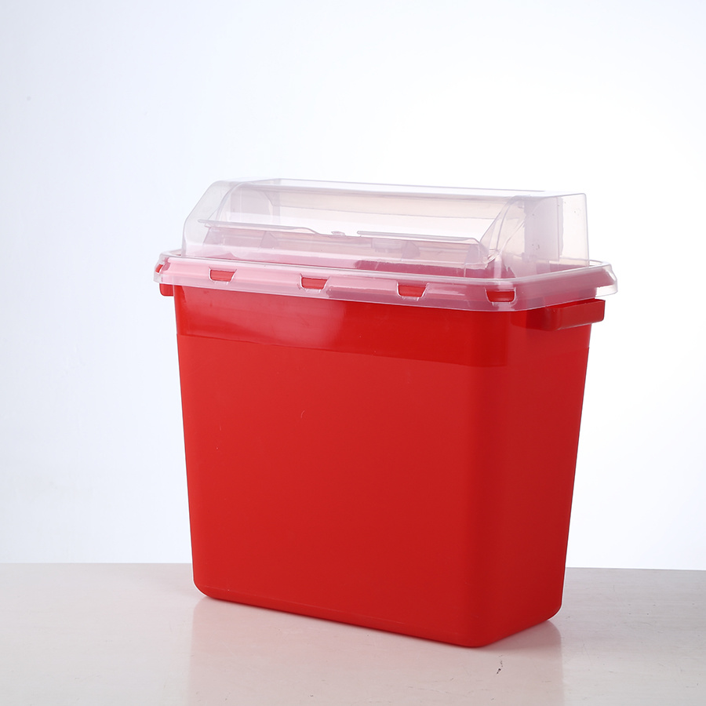
Hazardous Waste Containers commonly used

Slide 55
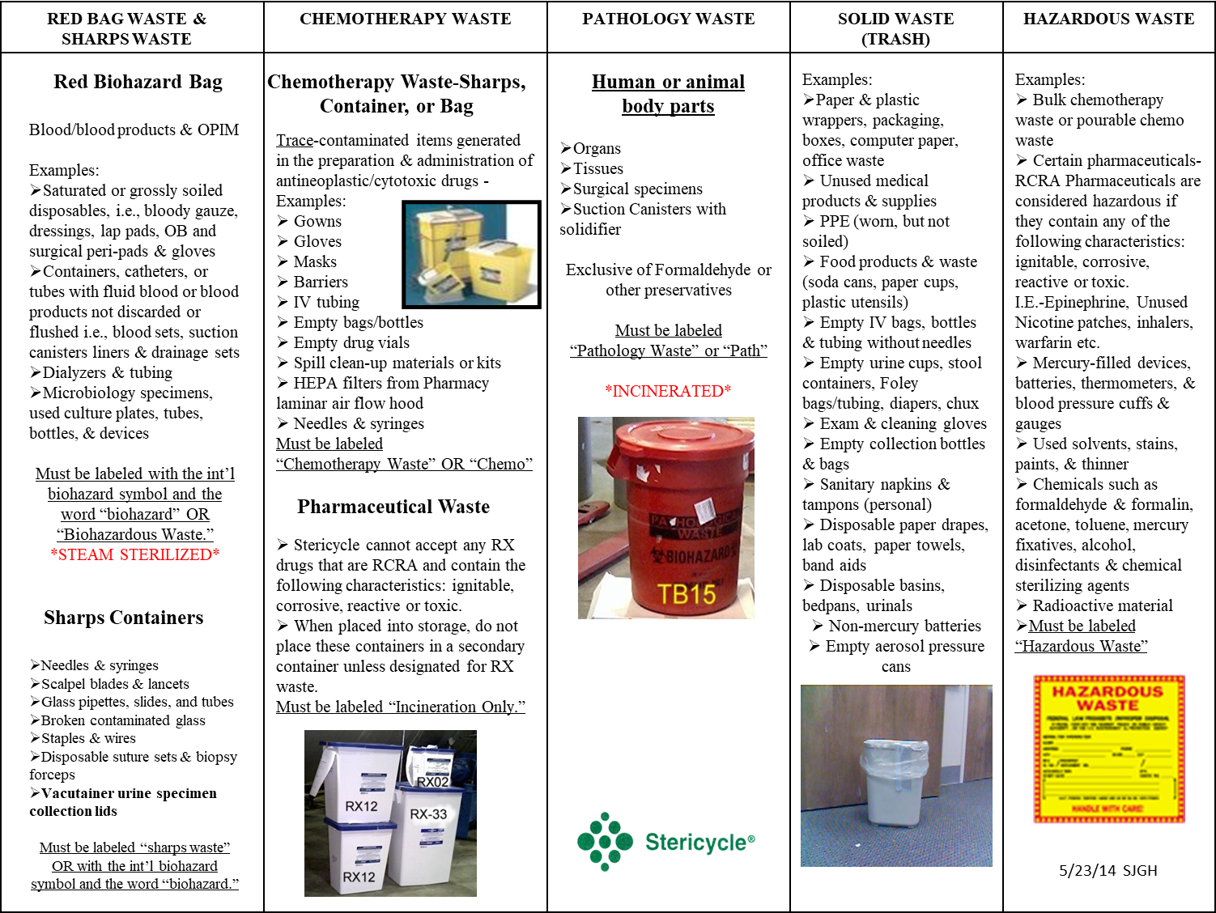

Slide 56
Biohazard Material Waste Disposal (CDC)
Disinfect, sterilize, inactivate or burn depending on its type and how contagious it is.
Separate infectious materials from noninfectious.
Red, Leak-proof , puncture-resistant containers, labeled w/international symbol.
Plastic bags contained in a designated rigid or semi-rigid container. Keep containers covered during transport.
Store for as short a period as possible. Pack to reduce exposure to rodents, vermin and other animals.
Use state or local government approved disposal options.

Slide 57

Handling of Linen to Prevent Spread of Infection
Always wash hands, then apply gloves
Change linen between each patient AND when soiled AND as needed
Prevent aerosols → DO NOT “fluff”
DO roll linens up
DO NOT carry linen close to body/uniform
Inspect for hazardous instruments/sharps before stripping bed
Contain linen in an impervious linen bag and tie the top shut
Remove gloves, then do Hand Hygiene

Slide 58


Any questions?

Slide 59
Appreciation
Charo Jumaoas, RN MSN, CPHQ, HACP Deputy Director Standards & Compliance- “The Boss”
Adriana Mejia, BSN, RN, PHN- Quality Coordinator- My relief for GO, and my collaborator and sounding board!
Kathy Medeiros, BA Management Analyst III- Oversight of office and Guru of graphs
Scott Cassinelli, Sr Office Assistant- Hand Hygiene Guru & Snack maker extraordinaire
Rona Bonaventura, Office Tech Assistant- My “go to” person for all things tech & Lumpia
Jen Hirai, D. Pharm, Risk Management Analyst – a resource for all things risk & overall common sense
De Julianne Angeles, MD EHS who tirelessly assures we are working safety & taken care of
Betty Jo Riendel, RN DM Clinics/EHS Assures employees get help when they need it
Cecilia Cueto, HR Analyst SJGH – who started me (Steven) on this journey at SJGH
Phyllis Sloneski. MSN, RN - Mom- “Healthcare is not just medicines and machines, its about caring, listening, educating, treating, giving all you got- and often a smile, a tender touch and an open ear is means more than you know”

Slide 60
Reference
  Anderson, D.J., Podgorny, K., Berríos-Torres, S.I., Bratzler, D.W., Dellinger, E.P., Greene, L., Nyquist, A., Saiman, L., Yokoe, D.S., Maragakis, L.L. & Kaye, K.S. (2014). Strategies to Prevent Surgical Site Infections in Acute Care Hospitals: 2014 Update. Infection Control and Hospital Epidemiology 35(6), 605-627. https://doi.org/10.1086/676022
CDC NIOSH-Approved Particulate Filtering Facepiece Respirators. https://www.cdc.gov/niosh/npptl/topics/respirators/disp_part/default.html
HAC National Scorecard 2014-16. Content last reviewed November 2019. Agency for Healthcare Research and Quality, Rockville, MD. https://www.ahrq.gov/data/infographics/hac-scorecard-2014- 16.html
Mangram, A.J., Horan, T.C., Pearson, M.L., Silver, L.C. & Jarvis, W.R. (1999). Guideline for prevention of surgical site infection, 1999. Centers for Disease Control and Prevention (CDC) hospital infection controo practices advisory committee. Infect Control Hosp Epidemiology, 20(4):250-278.
Institute for Healthcare Improvement [IHI] (Retrieved 2022) 5 Million lives. http://ihi.org/IHI/Programs/Campaign/Campaign.htm
National Center for Emerging and Zoonotic Infectious Diseases. (2021). Current HAI progress report. Current HAI Progress Report | HAI | CDC
U.S. Department of Health and Human Services [USDHHS] (2021). National HAI targets and metrics. https://www.hhs.gov/oidp/topics/health-care-associated-infections/targets- metrics/index.html#ftn2

Slide 61
THANK YOU
For questions…
Contact Infection Prevention at Ext: 8-6275
Email: sjghinfectioncontrol.org or ssloneski@SJGH.org

